Slide 1
Diagramming Sentences Tutorial

Slide 2
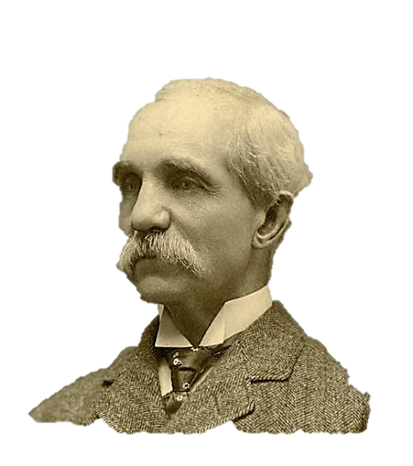
Diagramming sentences is a traditional method (old-fashioned, maybe?) of teaching grammar.
Alonzo reed
Brainerd Kellogg
Unlike you, Brainerd, there are no public records of my existence beyond my dying in 1899.
What’s with the paper bag, Alonzo?
What
are
diagrams
sentence
Most diagrammers give props to the two masters as the originators of the technique:

Slide 3
Reed-Kellogg Sentence Diagramming
The system breaks down all sentences into ten patterns and helps us learn about how each individual word works in the sentence by forcing us to manipulate each word into its proper position and purpose.

Slide 4
Patterns I-III use TO BE verbs

Slide 5
Pattern I: NP – BE – ADV T/P
NP is a Noun Phrase. It is the SUBJECT.
BE is a TO BE verb: Is, Are, Was, Were, Am, Be, Being, Been
ADV T/P is an Adverbial of Time or Place
NP
BE
Always begin with the base line and a bisecting line to separate the Subject + Predicate.
Notice that the adverbial connects to the verb because it explains when or where the subject is.
And always on a slanted line.
Adverbial

Slide 6
Pattern I: NP – BE – ADV T/P
Example #1: Christmas is tomorrow.
Christmas
is
Answers WHEN as an adverbial question.
tomorrow
Adverbs usually connect to the verb.

Slide 7
Pattern I: NP – BE – ADV T/P
IN THE ZOO is an adverbial prep phrase.
Example #2: The monkey is in the zoo.
Down with the prep. Across with the noun.
monkey
is
prep
noun

Slide 8
Pattern I: NP – BE – ADV T/P
IN THE ZOO is an adverbial prep phrase.
Example #2: The monkey is in the zoo.
Down with the prep. Across with the noun.
monkey
is
prep
noun

Slide 9
Pattern I: NP – BE – ADV T/P
IN THE ZOO is an adverbial prep phrase.
Example #2: The monkey is in the zoo.
Determiners like THE connect to NOUNS they determine. Place them on a diagonal line.
Down with the prep. Across with the noun.
monkey
is
in
zoo
determiner

Slide 10
Pattern I: NP – BE – ADV T/P
IN THE ZOO is an adverbial prep phrase.
Example #2: The monkey is in the zoo.
Determiners like THE connect to NOUNS they determine. Place them on a diagonal line.
monkey
is
in
zoo
determiner

Slide 11
Pattern I: NP – BE – ADV T/P
IN THE ZOO is an adverbial prep phrase.
Example #2: The monkey is in the zoo.
monkey
is
in
The
zoo
det

Slide 12
Pattern I: NP – BE – ADV T/P
IN THE ZOO is an adverbial prep phrase.
Example #2: The monkey is in the zoo.
monkey
is
in
The
zoo
det

Slide 13
Pattern I: NP – BE – ADV T/P
IN THE ZOO is an adverbial prep phrase.
Example #2: The monkey is in the zoo.
monkey
is
in
The
zoo
the

Slide 14
Pattern I: NP – BE – ADV T/P
Example #3: The pumpkin pies are in the pantry.
pies
are
PUMPKIN is an Adjective. It modifies PIES, so connect it on its own diagonal line.
The
in
pantry
the

Slide 15
Pattern I: NP – BE – ADV T/P
Example #3: The pumpkin pies are in the pantry.
pies
are
PUMPKIN is an Adjective. It modifies PIES, so connect it on its own diagonal line.
The
in
pantry
Adjective
the

Slide 16
Pattern I: NP – BE – ADV T/P
Example #3: The pumpkin pies are in the pantry.
pies
are
The
in
pantry
Adjective
the

Slide 17
Pattern I: NP – BE – ADV T/P
Example #3: The pumpkin pies are in the pantry.
pies
are
The
in
pantry
pumpkin
the

Slide 18
Pattern II: NP – BE – ADJ
NP is a Noun Phrase. It is the SUBJECT.
BE is a TO BE verb: Is, Are, Was, Were, Am, Be, Being, Been
ADJ is the Predicate Adjective (or Subject Complement)
NP
BE
Adj
Draw a slanted line leaning toward the subject, but notice how it does NOT pass through.
The Predicate Adjective is unlike a traditional adjective, which connects under the noun it modifies. Instead, it follows the TO BE verb on the main line.

Slide 19
Pattern II: NP – BE – ADJ
Example #1: The cost of a college education is outrageous.
Modifies the word COST but follows the verb IS.
Cost
is
outrageous
The
of
education
a
college

Slide 20
Pattern II: NP – BE – ADJ
Example #2: These sentence diagrams are archaic yet fun.
diagrams
are
EEEK! There are two Predicate Adjectives!
This doesn’t change the pattern, but it changes the diagram. Let’s split the Predicate Adjective slot into two.

Slide 21
Pattern II: NP – BE – ADJ
Example #2: These sentence diagrams are archaic yet fun.
diagrams
are
EEEK! There are two Predicate Adjectives!
This doesn’t change the pattern, but it changes the diagram. Let’s split the Predicate Adjective slot into two.

Slide 22
Pattern II: NP – BE – ADJ
Example #2: These sentence diagrams are archaic yet fun.
archaic
diagrams
are
yet
The conjunction YET will join the two Predicate Adjectives on a dashed line.
fun

Slide 23
Pattern II: NP – BE – ADJ
Example #2: These sentence diagrams are archaic yet fun.
archaic
diagrams
are
yet
The conjunction YET will join the two Predicate Adjectives on a dashed line.
These
fun
sentence

Slide 24
Pattern II: NP – BE – ADJ
Example #3: Many of the field hockey players were out of shape.
Many
were
Remember that the subject must be a Noun Phrase, not a Prep Phrase.
So, you can’t choose PLAYERS as the subject.

Slide 25
Pattern II: NP – BE – ADJ
Let’s show how FIELD modifies HOCKEY, not PLAYERS.
Example #3: Many of the field hockey players were out of shape.
Many
were
Remember that the subject must be a Noun Phrase, not a Prep Phrase.
of
So, you can’t choose PLAYERS as the subject.
players
the
hockey
field

Slide 26
Pattern II: NP – BE – ADJ
Let’s show how FIELD modifies HOCKEY, not PLAYERS.
Example #3: Many of the field hockey players were out of shape.
Many
were
of
players
the
hockey
field

Slide 27
Pattern II: NP – BE – ADJ
Example #3: Many of the field hockey players were out of shape.
Many
were
How can OUT OF SHAPE be an adjective?
of
It is an IDIOM for UNFIT.
players
the
hockey
field

Slide 28
Pattern II: NP – BE – ADJ
Example #3: Many of the field hockey players were out of shape.
Many
were
How can OUT OF SHAPE be an adjective?
So diagram it like it is: a prep phrase. But set it in the position of the Predicate Adjective. Build it on a diagram tree.
A tree has a triangle base and a stem.
of
It is an IDIOM for UNFIT.
players
the
hockey
field

Slide 29
Pattern II: NP – BE – ADJ
Example #3: Many of the field hockey players were out of shape.
out of
shape
Many
were
So diagram it like it is: a prep phrase. But set it in the position of the Predicate Adjective. Build it on a diagram tree.
A tree has a triangle base and a stem.
of
players
the
hockey
field

Slide 30
Pattern III: NP₁ – BE – NP₁
NP₁ is a Noun Phrase. It is the SUBJECT.
BE is a TO BE verb: Is, Are, Was, Were, Am, Be, Being, Been
NP₁ is the Predicate Nominative (or Subject Complement)
That’s right, bag head. The slanted line indicates a Subject Complement. But Pattern III uses a Noun to rename the Subject. That’s what the subscript 1 means.
NP₁
BE
NP₁
This looks just like Pattern II with the slanted line.

Slide 31
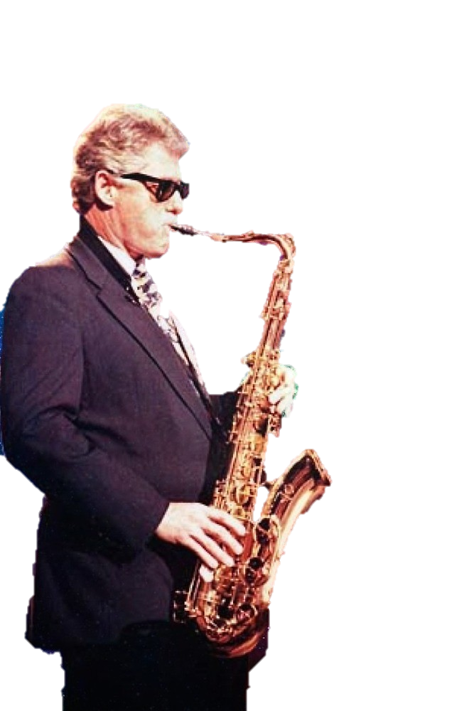
Pattern III: NP₁ – BE – NP₁
Example #1: President Clinton was a saxophone player.
Renames the subject with a noun.
President Clinton
was
player
a
saxophone

Slide 32
Pattern III: NP₁ – BE – NP₁
Example #2: Neither the Phillies nor the Pirates will be World Series champions this year.
Let’s split that subject line.

Slide 33
Pattern III: NP₁ – BE – NP₁
Example #2: Neither the Phillies nor the Pirates will be World Series champions this year.
Phillies
the
will be
champions
Let’s split that subject line.
neither nor
year
Pirates
this
World Series
the

Slide 34
Patterns IV-V use LINKING verbs

Slide 35
Pattern IV: NP – LV – ADJ
NP is a Noun Phrase. It is the SUBJECT.
LV is a LINKING verb: Feel, Seem, Become, Taste, Appear, Sound, Smell, Turn, etc.
ADJ is the Predicate Adjective (or Subject Complement)
Quiet, Bag Head. There is a critical difference between a TO BE Verb and Linking Verb.
NP
LV
Adj
Pattern II looks just like Pattern IV!!

Slide 36
Pattern IV: NP – LV – ADJ
Example #1: The cost of a college education sounds outrageous.
Cost
sounds
outrageous
Alonzo, can you hear the difference between “The cost IS outrageous” and “The cost SOUNDS outrageous,” Alonzo?
The
I can’t hear you through this paper bag.
of
education
a
college

Slide 37
Pattern IV: NP – LV – ADJ
Example #2: This casserole looks disgusting yet tastes yummy.
casserole
Wait! There are two verbs, and each has its own Predicate Adjective. Let’s adjust the diagram.

Slide 38
Pattern IV: NP – LV – ADJ
Example #2: This casserole looks disgusting yet tastes yummy.
looks
disgusting
casserole
yet
This
Wait! There are two verbs, and each has its own Predicate Adjective. Let’s adjust the diagram.
tastes
yummy

Slide 39
Pattern IV: NP – LV – ADJ
Example #3: With this high fever I feel under the weather.
under
weather
the
I
feel
Be sure you can recognize that “under the weather” is literally a Prep Phrase . . .
. . . but figuratively an idiom for feeling ill.

Slide 40
Pattern IV: NP – LV – ADJ
Example #3: With this high fever I feel under the weather.
under
weather
the
I
feel
Be sure you can recognize that “under the weather” is literally a Prep Phrase . . .
with
. . . but figuratively an idiom for feeling ill.
fever
this
high

Slide 41
Pattern IV: NP – LV – ADJ
Example #3: With this high fever I feel under the weather.
under
weather
the
I
feel
“With this high fever” could modify how I feel or why I feel under the weather.
with
fever
this
high

Slide 42
Predicate Adjectives
Follow the linking verb or To Be verb
Modifies the Subject
Forms Pattern II and IV

Slide 43
Pattern V: NP₁ – LV – NP₁
NP₁ is a Noun Phrase. It is the SUBJECT.
LV is a LINKING verb: Feel, Seem, Become, Taste, Appear, Sound, Smell, Turn, etc.
NP₁ is the Predicate Nominative (or Subject Complement)
Again, the Subject is renamed with another noun. But the Linking Verb is the only difference.
NP₁
LV
NP₁
Clearly, this is just like Pattern III.

Slide 44
Pattern V: NP₁ – LV – NP₁
Example #1: Advanced Grammar has become a popular course.
Advanced Grammar
has become
course
a
popular

Slide 45
Pattern V: NP₁ – LV – NP₁
Example #2: That sounds like a lousy plan.
So diagram it as a prep phrase but connect it to the Predicate Nominative slot on a tree.
That
sounds
In Reed-Kellogg diagraming, we treat a simile as a noun.

Slide 46
Pattern V: NP₁ – LV – NP₁
Example #2: That sounds like a lousy plan.
like
plan
a
So diagram it as a prep phrase but connect it to the Predicate Nominative slot on a tree.
lousy
That
sounds
In Reed-Kellogg diagraming, we treat a simile as a noun.

Slide 47
Pattern V: NP₁ – LV – NP₁
Example #3: General Tso’s Chicken is and always will be my favorite food.
is
General Tso’s Chicken
and
Let’s begin with one subject and two verbs.
Notice how it IS food and ALWAYS WILL BE food. So the verbs coalesce into one noun.
will be

Slide 48
Pattern V: NP₁ – LV – NP₁
Example #3: General Tso’s Chicken is and always will be my favorite food.
is
General Tso’s Chicken
food
and
Let’s begin with one subject and two verbs.
Notice how it IS food and ALWAYS WILL BE food. So the verbs coalesce into one noun.
will be
my
favorite
always

Slide 49
Predicate Nominatives
Follow the linking verb or To Be verb
Answer questions What or Who
Forms Pattern III and V

Slide 50
Patterns VI-X use ACTION verbs

Slide 51
Pattern VI: NP – V-int
NP is a Noun Phrase. It is the SUBJECT.
V-int is an intransitive verb, a type of action verb.
NP
V-int
You will notice that it is similar to Pattern I. But there is no Adverbial.
But oftentimes an Adverbial will be included in these sentences. In fact, an Adverbial is optional but common in all nine patterns except for Pattern I, where it is required.

Slide 52
Pattern VI: NP – V-int
Example #1: Alonzo swam in the Jell-O.
. . . but this Adverbial Prep Phrase is optional.
Alonzo
swam
Unlike Pattern I, if we remove the Adverbial, Pattern VI will still make sense.
in
Jell-O
This adds a detail to the sentence . . .
the

Slide 53
Pattern VI: NP – V-int
Example #2: Brainerd is knitting by the fire.
IS KNITTING is the whole verb.
Brainerd
is knitting
IS by itself is a TO BE verb. But here it is an auxiliary verb for KNITTING, which is the main verb.
by
fire
the

Slide 54
Pattern VI: NP – V-int
Example #3: The hippie was in the sunflower field and danced with his tambourine.
Pattern I
was
hippie
in
field
and
WAS is a TO BE verb. DANCED is an ACTION verb. This sentence is both Pattern I and Pattern VI.
the
The
danced
sunflower
with
Pattern VI
tambourine
his

Slide 55
Pattern VII: NP₁ – V-tr – NP₂
NP₂ is distinct from NP₁.
NP₁ is a Noun Phrase. It is the SUBJECT.
V-tr is a transitive verb.
NP₂ is a Noun Phrase. It is the DIRECT OBJECT.
NP₁
V-tr
NP₂
You will notice that the line separating the Verb from the Direct Object is now perpendicular.
The Direct Object always follows the Action Verb. It answers WHAT or WHOM.

Slide 56
Pattern VII: NP₁ – V-tr – NP₂
Example #1: Alonzo wore a bag on his head.
Alonzo
wore
bag
a
on
Very funny, Brainerd.
head
his

Slide 57
Pattern VII: NP₁ – V-tr – NP₂
Example #2: We looked up the answers online.
“looked up” is a phrasal verb.
We
looked up
answers
A Phrasal Verb is part verb + part particle. A particle looks like a preposition.
the
online
Answers where? It’s an adverb.

Slide 58
Pattern VII: NP₁ – V-tr – NP₂
Example #3: A bunch of knuckleheads released a dozen piglets in the visitors’ locker room.
bunch
released
piglets
Notice how “dozen” modifies “piglets” and “a” is a determiner for “dozen.”
a
in
room
dozen
a
of
the
knuckleheads
locker
visitors’

Slide 59
Direct Objects
Follow the action verb
Answer questions What or Whom
Forms Pattern VII – but is necessary for Patterns VII, IX, and X too.

Slide 60
Pattern VIII: NP₁ – V-tr – NP₂ – NP₃
NP₁, NP_{2,} & NP₃ are all distinct nouns
NP₁ is a Noun Phrase. It is the SUBJECT.
V-tr is a transitive verb.
NP₂ is a Noun Phrase. It is the INDIRECT OBJECT.
NP₃ is a Noun Phrase. It is the DIRECT OBJECT.
NP₁
V-tr
NP₃
The Indirect Object answers the questions TO/FOR WHOM or TO/FOR WHAT.
The Direct Object now becomes NP₃ and follows the Indirect Object.
NP₂

Slide 61
Pattern VIII: NP₁ – V-tr – NP₂ – NP₃
NP₁, NP_{2,} & NP₃ are all distinct nouns
NP₁ is a Noun Phrase. It is the SUBJECT.
V-tr is a transitive verb.
NP₂ is a Noun Phrase. It is the INDIRECT OBJECT.
NP₃ is a Noun Phrase. It is the DIRECT OBJECT.
NP₁
V-tr
NP₃
The Indirect Object answers the questions TO/FOR WHOM or TO/FOR WHAT.
The Direct Object now becomes NP₃ and follows the Indirect Object.
NP₂

Slide 62
Pattern VIII: NP₁ – V-tr – NP₂ – NP₃
NP₁, NP_{2,} & NP₃ are all distinct nouns
NP₁ is a Noun Phrase. It is the SUBJECT.
V-tr is a transitive verb.
NP₂ is a Noun Phrase. It is the INDIRECT OBJECT.
NP₃ is a Noun Phrase. It is the DIRECT OBJECT.
NP₁
V-tr
NP₃
You have three options: #1 add the missing word in parentheses.
The Indirect Object is essentially a Prep Phrase with “to” or “for” omitted.
(to)
NP₂

Slide 63
Pattern VIII: NP₁ – V-tr – NP₂ – NP₃
NP₁, NP_{2,} & NP₃ are all distinct nouns
NP₁ is a Noun Phrase. It is the SUBJECT.
V-tr is a transitive verb.
NP₂ is a Noun Phrase. It is the INDIRECT OBJECT.
NP₃ is a Noun Phrase. It is the DIRECT OBJECT.
NP₁
V-tr
NP₃
You have three options: #1 add the missing word in parentheses.
The Indirect Object is essentially a Prep Phrase with “to” or “for” omitted.
(to)
NP₂

Slide 64
Pattern VIII: NP₁ – V-tr – NP₂ – NP₃
NP₁, NP_{2,} & NP₃ are all distinct nouns
NP₁ is a Noun Phrase. It is the SUBJECT.
V-tr is a transitive verb.
NP₂ is a Noun Phrase. It is the INDIRECT OBJECT.
NP₃ is a Noun Phrase. It is the DIRECT OBJECT.
NP₁
V-tr
NP₃
You have three options: #2 write an X for the missing word.
The Indirect Object is essentially a Prep Phrase with “to” or “for” omitted.
X
NP₂

Slide 65
Pattern VIII: NP₁ – V-tr – NP₂ – NP₃
NP₁, NP_{2,} & NP₃ are all distinct nouns
NP₁ is a Noun Phrase. It is the SUBJECT.
V-tr is a transitive verb.
NP₂ is a Noun Phrase. It is the INDIRECT OBJECT.
NP₃ is a Noun Phrase. It is the DIRECT OBJECT.
NP₁
V-tr
NP₃
You have three options: #2 write an X for the missing word.
The Indirect Object is essentially a Prep Phrase with “to” or “for” omitted.
X
NP₂

Slide 66
Pattern VIII: NP₁ – V-tr – NP₂ – NP₃
NP₁, NP_{2,} & NP₃ are all distinct nouns
NP₁ is a Noun Phrase. It is the SUBJECT.
V-tr is a transitive verb.
NP₂ is a Noun Phrase. It is the INDIRECT OBJECT.
NP₃ is a Noun Phrase. It is the DIRECT OBJECT.
NP₁
V-tr
NP₃
You have three options: #3 leave it blank.
The Indirect Object is essentially a Prep Phrase with “to” or “for” omitted.
NP₂

Slide 67
Pattern VIII: NP₁ – V-tr – NP₂ – NP₃
Example #1: Alonzo gave Brainerd a noogie.
Alonzo
gave
noogie
a
What is a noogie, Alonzo?
(to)
You are so old, Brainerd.
Brainerd

Slide 68
Pattern VIII: NP₁ – V-tr – NP₂ – NP₃
Example #2: Grandma bought them a jar of pickles.
Grandma
bought
jar
a
of
pickles
(to)
them

Slide 69
Pattern VIII: NP₁ – V-tr – NP₂ – NP₃
Example #3: The hippies handed us flower crowns and pamphlets on meditation and yoga.
crowns
hippies
handed
flower
and
(to)
pamphlets
The
us
meditation
Here we have two Direct Objects. So go ahead and split it.
on
and
yoga

Slide 70
Indirect Objects
Found between the action verb and direct object
Answer questions To / For What or To / For Whom
Kind of like prep phrases without the preposition

Slide 71
Pattern IX: NP₁ – V-tr – NP₂ – Adj
NP₁ is a Noun Phrase. It is the SUBJECT.
V-tr is a transitive verb.
It “completes” the object.
NP₂ is a Noun Phrase. It is the DIRECT OBJECT.
Adj is an Adjective. It is the Objective Complement.
NP₁
V-tr
NP₂
So, like a Predicate Adjective, place it on the main line after a slanted line.
Here the final adjective following the Direct Object modifies that Direct Object.

Slide 72
Pattern IX: NP₁ – V-tr – NP₂ – Adj
NP₁ is a Noun Phrase. It is the SUBJECT.
V-tr is a transitive verb.
It “completes” the object.
NP₂ is a Noun Phrase. It is the DIRECT OBJECT.
Adj is an Adjective. It is the Objective Complement.
NP₁
V-tr
NP₂
Adj
So, like a Predicate Adjective, place it on the main line after a slanted line.
Here the final adjective following the Direct Object modifies that Direct Object.

Slide 73
Pattern IX: NP₁ – V-tr – NP₂ – Adj
Example #1: We considered the hobo’s odor oppressive.
We
considered
odor
oppressive
the
hobo’s

Slide 74
Pattern IX: NP₁ – V-tr – NP₂ – Adj
Example #2: The Steeler fans painted their faces black and gold.
black
fans
painted
faces
and
The
their
gold
Steeler

Slide 75
Pattern IX: NP₁ – V-tr – NP₂ – Adj
Example #3: I find your cooking to be mediocre.
to be
I
find
cooking
mediocre
your
It floats on a satellite before the Objective Complement.
Sometimes an Objective Complement will be introduced with the expletive “to be” or “as.”

Slide 76
Pattern X: NP₁ – V-tr – NP₂ – NP₂
NP₁ is a Noun Phrase. It is the SUBJECT.
V-tr is a transitive verb.
It “completes” the object.
NP₂ is a Noun Phrase. It is the DIRECT OBJECT.
NP₂ is a Noun Phrase. It is the Objective Complement.
NP₁
V-tr
NP₂
NP₂
Here the Objective Complement renames the Direct Object with a noun.

Slide 77
Pattern X: NP₁ – V-tr – NP₂ – NP₂
Example #1: Few people consider NASCAR a sport.
people
consider
NASCAR
sport
a
Few

Slide 78
Pattern X: NP₁ – V-tr – NP₂ – NP₂
Example #2: The senior class elected Donnie as its president.
as
class
elected
Donnie
president
senior
its
The

Slide 79
Pattern X: NP₁ – V-tr – NP₂ – NP₂
Example #3: The Grammar Gods declared Brainerd and Alonzo to be geniuses.
to be
Brainerd
Gods
declared
geniuses
and
The
Grammar
Alonzo

Slide 80
Objective Complements
Follow the Direct Object
May be signaled with “as” or “to be”
Forms Patterns IX and X

